Slide 1








Power BI Dashboard
IPL ANALYSIS
By Tanmay Sharma

Slide 2


Project Overview
Objective:
The goal of this project is to analyze IPL (Indian Premier League) cricket data to gain insights into team and player performance, match outcomes, and various key metrics related to both batting and bowling.
The analysis leverages data from multiple related tables to provide a comprehensive view of the tournament's dynamics.
Data Sources:
Fact Bowling Summary
2. Fact Batting Summary
3. Dim Player
4. Dim Match Summary

Slide 3


Data Sources and Their Significance
Fact Bowling:
Contains detailed bowling data like overs bowled, wickets taken, runs conceded, etc.
Fact Batting Summary:
Provides a summary of batting performances including runs scored, balls faced, strike rate, etc.
Dim Player:
Details the player information including their team, batting style, and playing role.
Dim Match Summary:
Summarizes the match details such as teams playing, winner, margin of victory, and match date.

Slide 4
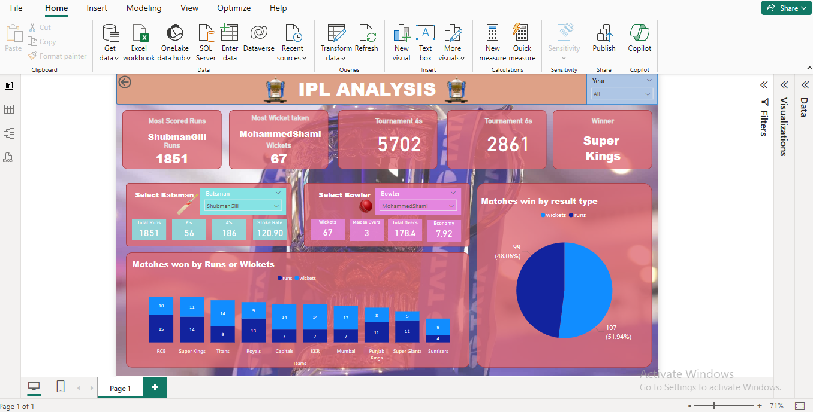


Slide 5


Dashboard Overview
Overview:
The dashboard is designed to allow users to interact with and explore IPL data from 2021, 2022, and 2023. It includes various visualizations and KPIs that provide insights into both team and individual performances.
Tiles in the Dashboard:
Year Filter (Slicer)
Batsman Stats
Bowler Stats
Match Win Analysis (Pie Chart)
Match Win Analysis by Team (Bar Chart)

Slide 6
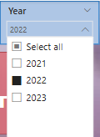

Tile 1 - Year Filter (Slicer)
Description:
This slicer allows users to filter the dashboard data by year, specifically 2021, 2022, and 2023. By selecting a specific year, all the other visuals on the dashboard update accordingly to reflect the chosen timeframe.
Purpose:
Enables focused analysis on a particular year.
Helps in comparing trends across different IPL seasons.

Slide 7
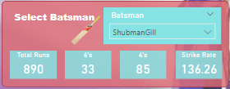
Tile 2 - Batsman Stats
Description:
This tile provides key performance indicators (KPIs) for batsmen, including total runs scored, boundaries hit, strike rate, and more. It also includes a slicer to filter data by individual batsman.
Metrics Displayed:
Total Runs
Boundaries (4s and 6s)
Strike Rate
Slicer for Batsman Selection
Purpose:
Offers a detailed view of a batsman's performance across different seasons.
Helps in identifying top performers and their impact on the game

Slide 8
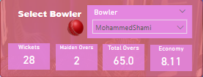
Tile 3 - Bowler Stats
Description:
Similar to the Batsman Stats tile, this tile focuses on bowlers. It includes KPIs such as overs bowled, maiden overs, wickets taken, and economy rate. A slicer allows users to filter data by individual bowler.
Metrics Displayed:
Overs Bowled
Maiden Overs
Wickets Taken
Economy Rate
Slicer for Bowler Selection
Purpose:
Provides insights into a bowler's effectiveness and consistency.
Enables comparison between different bowlers and their performances.

Slide 9
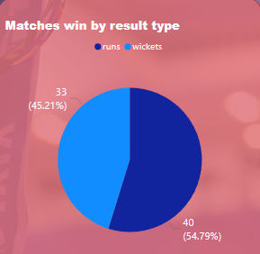
Tile 4 - Match Win Analysis (Pie Chart)
Description:
This pie chart visualizes the distribution of match wins by wickets or runs. It gives a quick overview of how teams have won their matches across the selected years.
Purpose:
Helps in understanding the most common types of victories in the IPL.
Provides insights into the strategies teams might be using to secure their wins.

Slide 10
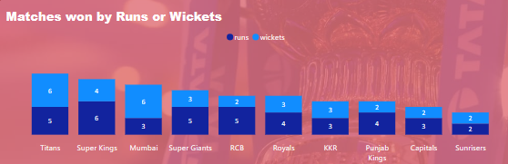
Tile 5 - Match Win Analysis by Team (Bar Chart)
Description:
This bar chart breaks down match wins by individual teams, showing whether the win was by wickets or runs. It allows for a detailed comparison of team performances across different seasons.
Purpose:
Highlights the strengths and weaknesses of each team.
Useful for analyzing team strategies and their effectiveness in different match situations.

Slide 11


Conclusion
Summary
The IPL Data Analysis dashboard provides comprehensive insights into the performance of teams and players in the IPL from 2021 to 2023.
The interactive elements like slicers and KPIs allow users to drill down into specific data points and uncover detailed trends and patterns.
Future Scope
Extend the analysis to include more seasons.
Incorporate additional metrics such as player form, venue performance, and head-to-head records.
Explore predictive analytics to forecast outcomes based on historical data.

Slide 12



About Me
Thank You !
"Hello, I'm Tanmay Sharma, a data science enthusiast skilled in Python and visualization libraries like Pandas, Matplotlib, and Seaborn. I have hands-on experience with SQL and Power BI, along with a creative flair and a passion for continuous learning."
Do check my work at:
LinkedIn
Github

